Slide 2

History of the Atomic Theory
  Atom is derived from the Greek word atomos meaning “unable to be divided”
Democritus, 4 BC

Slide 3
1808 – John Dalton, English schoolteacher
This is Dalton’s atomic theory (page 3)

Slide 4
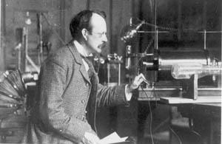

What’s in that beam?
Atomic Structure Packet pg 4
  J.J. Thomson, 1897
Cathode Ray Tube Experiments to measure the charge to mass ratio of the beam.
Particles in beam travel farther than hydrogen atoms.
The particles are 1000 times smaller than hydrogen atoms.

Slide 5
Thomson’s Model of the Atom 1897
Tiny negative particles
Matter is neutral
Dalton’s model

Slide 6
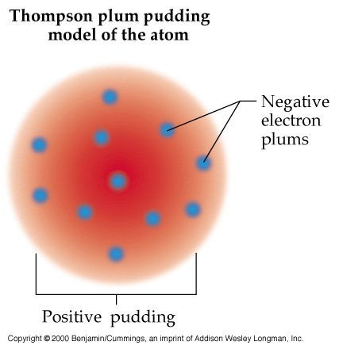
Thomson’s Model of the Atom 1897
Uniform base of positive charge with negative charges mixed within.

Slide 7
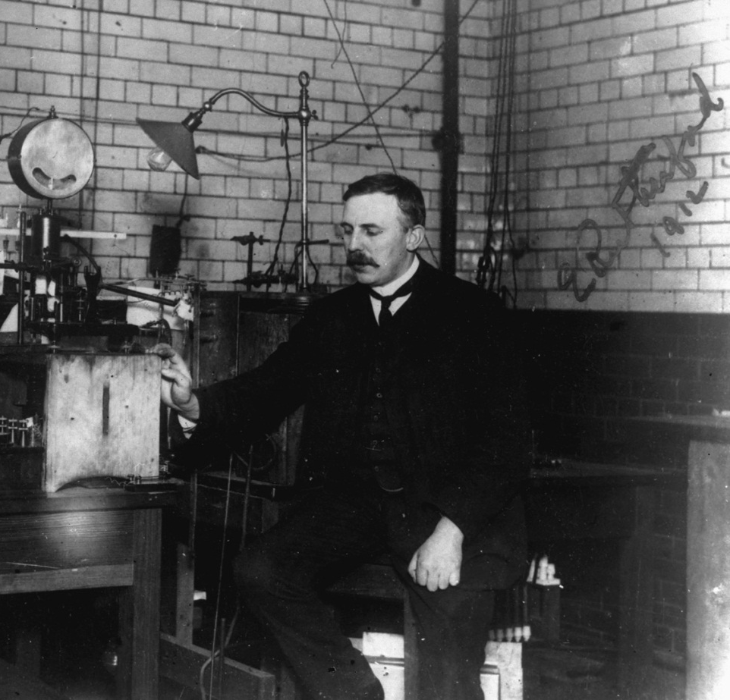
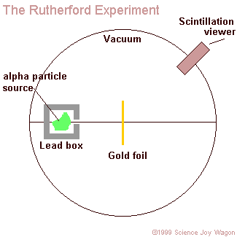
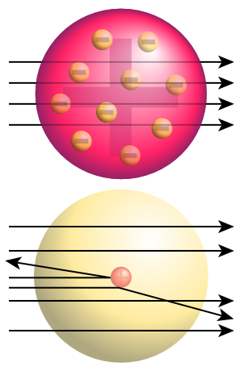
What’s the pudding? 1911
Ernest Rutherford’s Gold Foil Experiment

Slide 8
What’s the pudding? 1911
Ernest Rutherford’s Gold Foil Experiment
Determined that the atom is mostly empty space
Nucleus is a tiny, dense positive region
Contains all of an atom’s mass
Later concluded that nucleus contains positive units (protons)

Slide 9
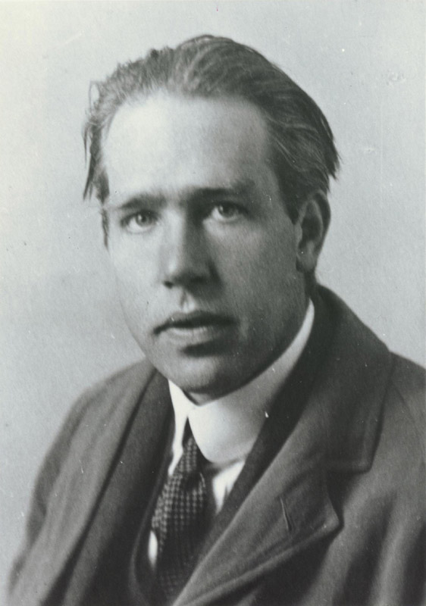
Niels Bohr – Explored the electrons in empty space
Danish physicist, 1913
Worked with Ernest Rutherford
Studied Hydrogen to learn about placement of electrons in atoms

Slide 10
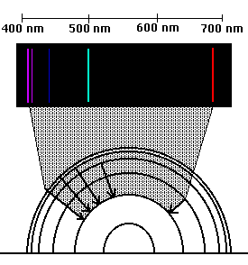
Bohr’s Data and Theory
Electrons exist in energy levels
Energy levels are structured like fixed orbits around the nucleus
Similar to planets orbiting the sun

Slide 11
Bohr’s model
Energy levels/electron orbits get larger as you move farther away from the nucleus
nucleus
Electrons will exist in the lowest possible energy level.

Slide 12

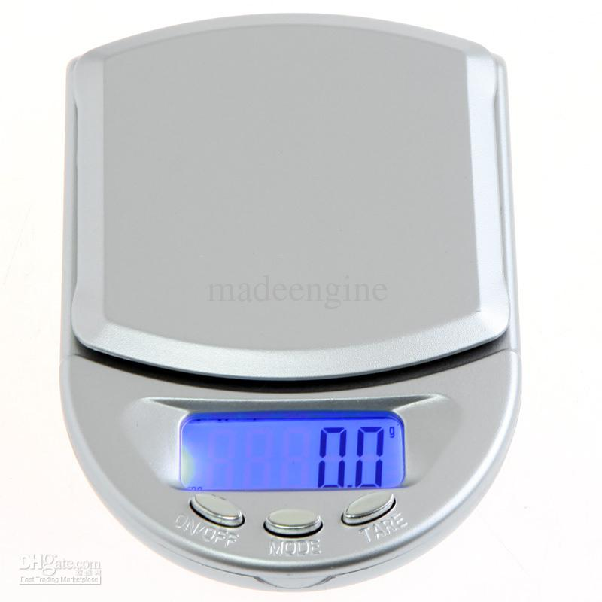
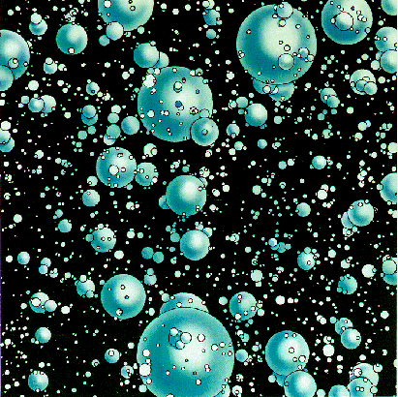
Completing the Atom
James Chadwick, co-worker of Rutherford, 1932
Disintegrated atoms
Protons = 25 amu
Original atom = 52 amu

Slide 13
Completing the Nucleus
James Chadwick, co-worker of Rutherford, 1932
Disintegrated atoms
Atoms have one more fundamental unit
No Charge
Mass same as proton
Called Neutron
Empty space
with electrons
Original atom = 52 amu

Slide 14
Atomic Mass and Weighted Averages

Slide 15

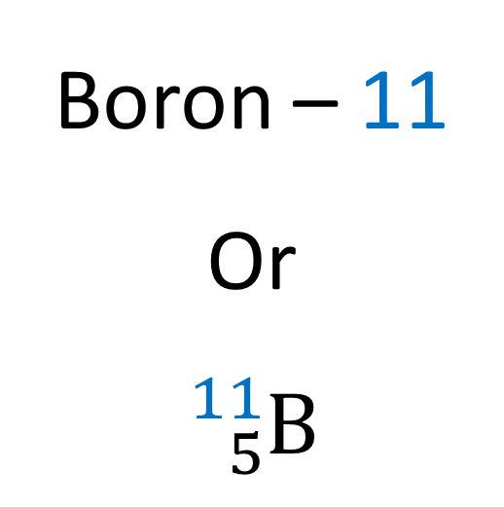
Mass Number vs. Atomic Mass
Boron – 11
Or
$${}_{5}^{11}{\text{B}}$$

Slide 16
Atomic Mass
The weighted average of all isotopes of an element.
It takes into account the abundance of each isotope for an element.
A proton has a mass of 0.9986 amu
A neutron has a mass of 1 amu
An electron has a mass of 0.00054387 amu

Slide 17
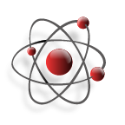
Comparing Atomic Mass and Mass Number
The average atomic mass of an atom of Uranium is 238.029 amu.
Light
Uranium-235 has a mass number of 235 amu.
Uranium-238 has a mass number of 238 amu.
Average

Slide 18
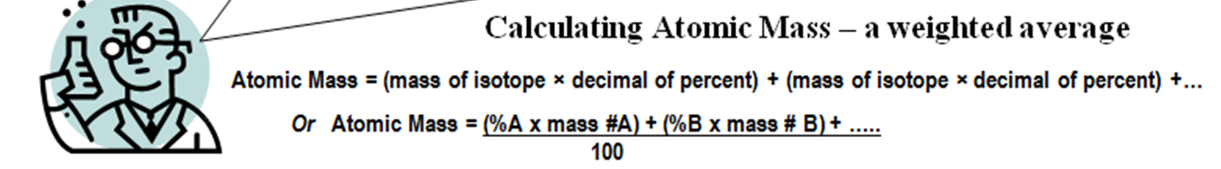
Calculate the average atomic mass of magnesium using the following data for three magnesium isotopes.
Isotope mass (amu) relative abundance
Mg-24 23.985 78.70%
Mg-25 24.986 10.13%
Mg-26 25.983 11.17%

Slide 19
Hydrogen is 99% ¹H, 0.8% ²H, and 0.2% ³H. Calculate its average atomic mass.

Slide 20
Answer

Slide 21
Working Backward:
The average atomic mass of copper is 63.55 amu.
If the only two isotopes of copper have masses of 62.94 amu and 64.93 amu, what are the percentages of each?
(Think algebra)

