Slide 1
Clear your desk completely
Review stats test
Review lewis structure quiz

Slide 2
Silently read over the steps to writing a lewis structure and formal charge rules

Slide 3
Phosphate (PO₄³⁻)
Draw the lewis structure (calc FC)
Identify shape names
Identify shape angles
Polar or nonpolar
Hybridization

Slide 4
sulfite (SO₃⁻²)
Draw the lewis structure (calc FC)
Identify shape names
Identify shape angles
Polar or nonpolar
hybridization

Slide 5
Station Review

Slide 6
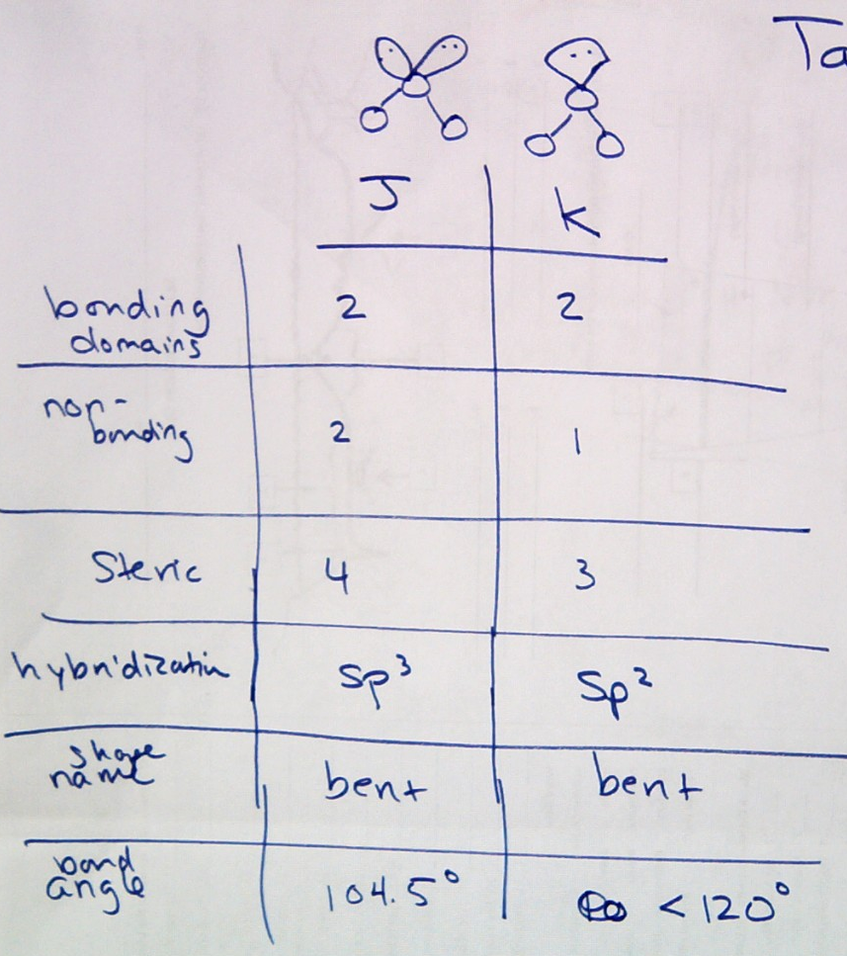
2

Slide 7
3

Slide 8
4
2
5
2
3

Slide 9
5
Always polar – bent, trigonal pyramidal, bent, see saw, t-shape, square pyramidal
Always nonpolar - none

Slide 10
6

Slide 11
7

Slide 12
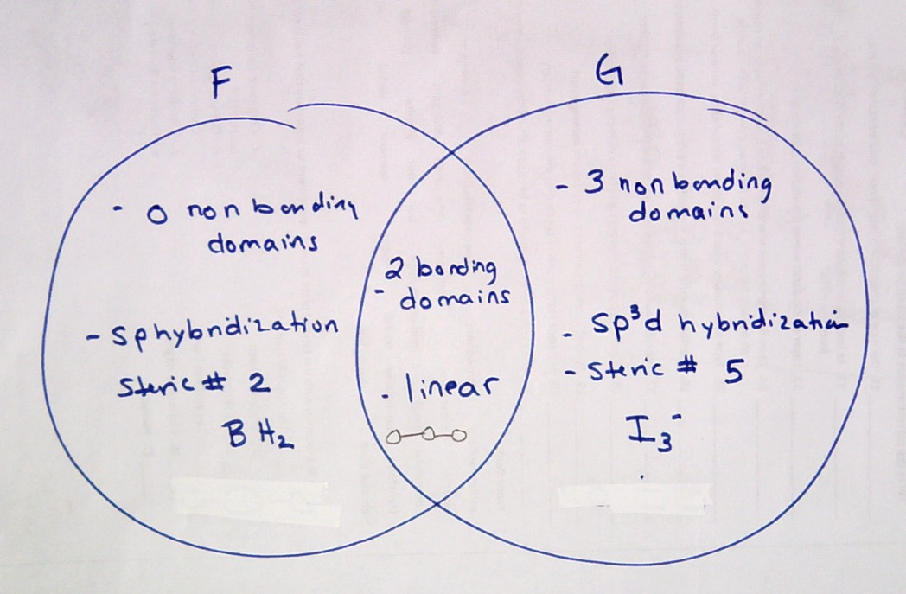
8

