Slide 1
Mixtures – can be separated based on physical properties (like state or boiling point)

Slide 2
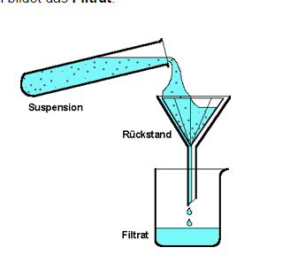
Filtration – separates a solid from a liquid based on the physical property of state

Slide 3
Distillation – separates a solution (2 liquids or liquid/solid) based on differences in physical property of boiling point (https://www.youtube.com/watch?v=xxNfJLMNS4E)
-the mixture is heated
-temperature rises until the boiling point of liquid A is reached
-liquid A boils into gas A
-gas A is condensed and collected

Slide 4
Pure Substances (compounds or elemental molecules) – Energy must be used to break bonds

Slide 5
Take Home Point
Mixtures can be separated physically
Pure substances must be separated chemically (must put in energy to break bonds)

