Slide 1
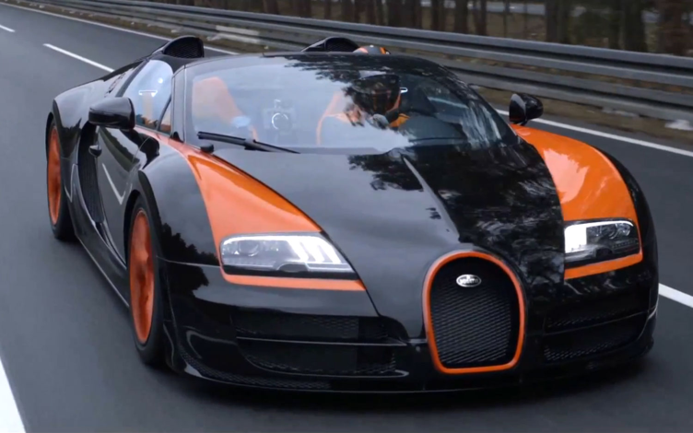
DA with Rates
The Bugatti Veyron can travel 1.2 X 10 ¹² Å per second. How many miles per hour is this?
Check your answer with your
group.

Slide 2
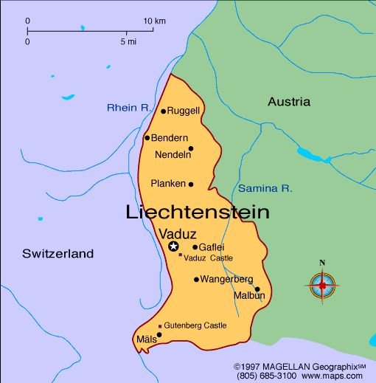
DA with squared
Liechtenstein is a country between Switzerland and Austria. It is 1.61 X 10 ¹² cm². How many square miles is it?

Slide 3
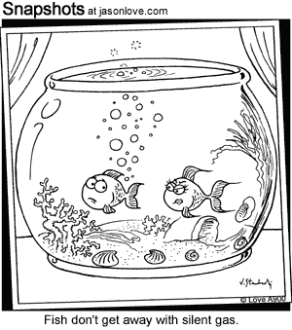
DA with cubed
The average human fart has a volume of
1.2 X10⁻³ ft³. Convert the average fart to mL.

